Slide 1
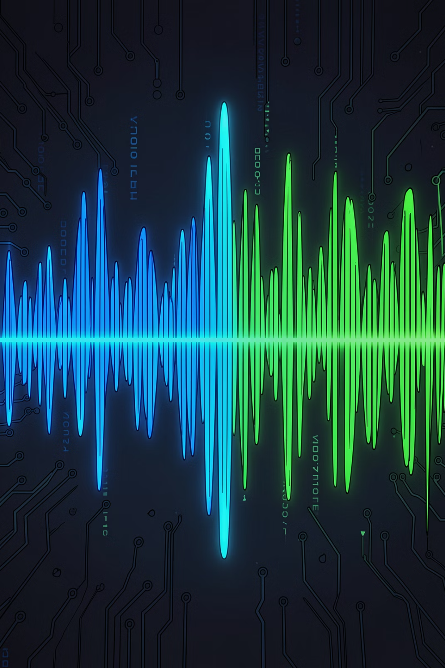
Deepfake Audio Detection in Call Centers
Conceptual Framework Using Spectral and Temporal Analysis
QASSIM UNIVERSITY · COLLEGE OF COMPUTER · IT DEPARTMENT · 1446/1447 (2025/2026)
Students: Muaz Abdullahi · Bilaminu Ishola · Hamzah Elnour · Md. Shakil Hossain · Ajmal Hamidi
Supervisor: Dr. Mahfoudh Saeed Ali Mohammed

Slide 2

The Deepfake Audio Threat
Generative AI now produces highly realistic synthetic speech, exposing voice authentication in call centers to three attack types:
Text-to-Speech (TTS)
Voice Conversion (VC)
Generates artificial speech from text using models like Tacotron + WaveNet, mimicking target voices without the attacker speaking.
Transforms an attacker's live speech to sound like a target speaker while preserving linguistic content — dangerous in real-time calls.
Replay Attacks
Replays pre-recorded genuine speech to bypass authentication; may include channel distortions from recording and playback.

Slide 3
Problem Statement
Existing detection systems are optimized for clean laboratory audio — failing under real-world telephony conditions.
Generalization Deficit
Real-Time Constraints
Performance degrades on unseen synthesis techniques and telephony distortions.
High-accuracy models fail to meet strict latency requirements for live call authentication.
Environmental Robustness
Integration Complexity
Codec compression, packet loss, and background noise obscure synthetic speech artifacts.
Most systems lack APIs or microservices for IVR, CRM, and fraud pipeline integration.

Slide 4
Research Questions & Objectives
Research Questions
Objectives
RQ1: Limitations of existing detection in call centers?
RQ2: How to combine spectral and temporal analysis?
RQ3: Which features best identify voice spoofing?
RQ4: How to design for real-time detection?
RQ5: How to ensure robustness against distortions and emerging techniques?
Review existing detection techniques and limitations
Examine spectral and temporal feature extraction methods
Design a unified spectral-temporal conceptual framework
Define key components and processes
Evaluate real-time telephony support
Propose robustness strategies against evolving deepfakes

Slide 5

Literature Review: Key Findings
Nine representative studies benchmarked — most achieve high accuracy on clean data but lack telephony robustness.
Study
Approach
Dataset
Result
Key Limitation
Shahzad et al. [21]
VGGish-LSTM
ASVspoof 2019 LA
99.11% Acc; EER 1.18%
Dataset dependency; overfitting
Verma et al. [22]
SE-1D CNN
ASVspoof 2019
97.64% Acc
High cost; limited accents
Kwak et al. [24]
ResMax
ASVspoof 2019
EER 0.37% (PA)
CQT-only; no temporal modeling
Chugh et al. [26]
VGG16/VGG19
Audio-visual
99.96% (STFT)
~138M params; no dropout
Malik & Changalvala [29]
Custom CNN
248 images
100% Acc
Tiny dataset; poor generalizability
Research Gap: No existing system combines spectral-temporal fusion, telephony robustness, real-time deployment, and continuous learning.

Slide 6
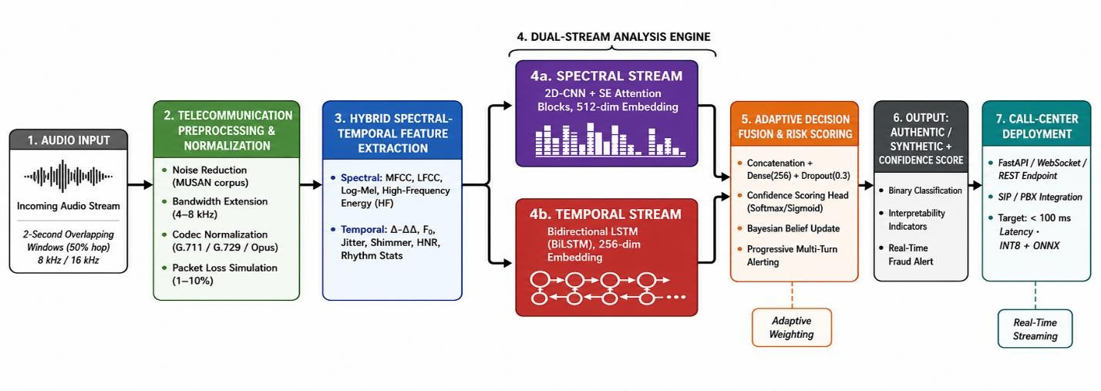
Proposed Conceptual Framework
The proposed conceptual framework for deepfake audio detection in call center environments

Slide 7
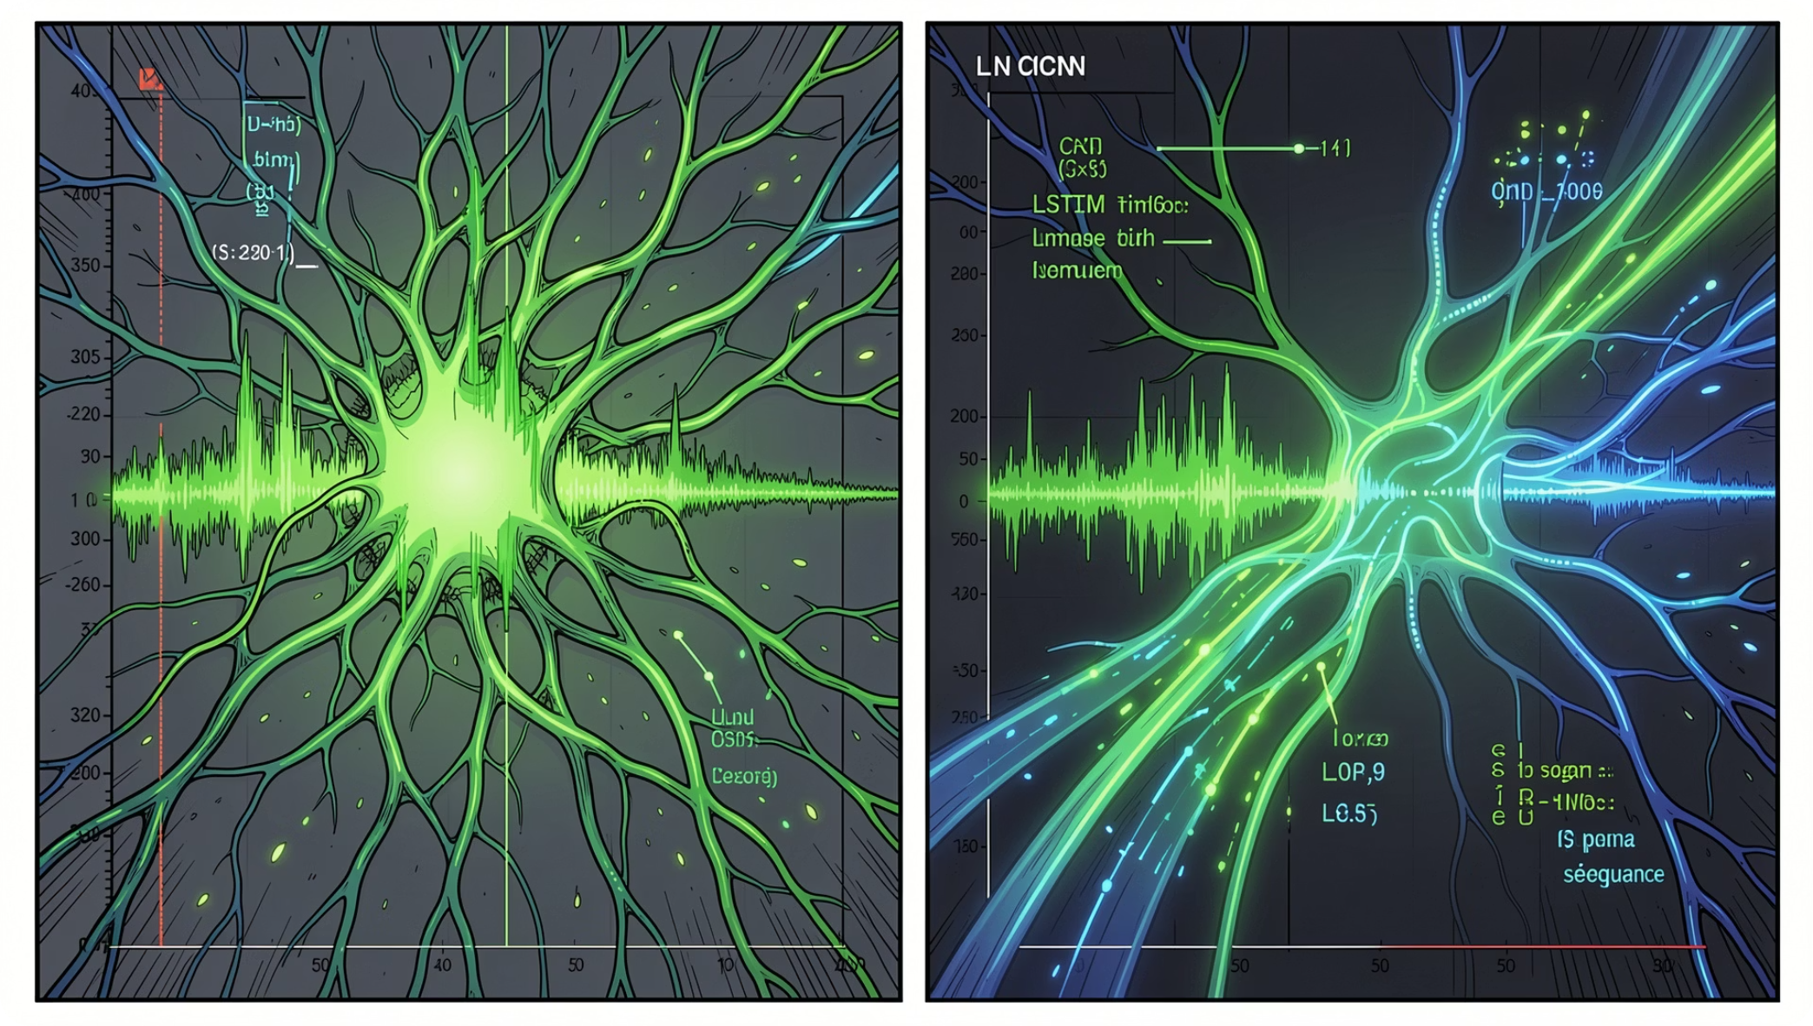
Dual-Stream Analysis Engine
Spectral Stream — 2D-CNN + SE Attention
Processes log-mel spectrograms (128 bins) with four convolutional blocks and Squeeze-and-Excitation attention. Detects irregular harmonics, spectral smoothing, and vocoder artifacts. Outputs a 512-dimensional spectral embedding.
Temporal Stream — BiLSTM
Two stacked BiLSTM layers (128 hidden units per direction) model long-range prosodic dependencies — rhythm, timing consistency, and articulation transitions. Outputs a 256-dimensional temporal embedding.
Fusion & Classification
Concatenated embeddings pass through a dense fusion layer (256 neurons, dropout 0.3) with softmax binary classification. Bayesian belief updating enables progressive multi-turn fraud alerting.

Slide 8
Implementation & Experimental Setup
Development Stack
Datasets
Python 3.10+ · TensorFlow 2.15 / PyTorch 2.1 · Librosa · FFmpeg · ONNX Runtime · FastAPI
ASVspoof 2019 (LA & PA) + ASVspoof 2021. Telephony degradation: G.711/G.729/Opus codecs, MUSAN noise at 5–20 dB SNR, 1–10% packet loss.
Training Config
Key Metrics
AdamW optimizer · Focal Loss (γ=2.0) · Cosine annealing · 5-fold cross-validation · Up to 50 epochs with early stopping
Accuracy, Precision, Recall, F1-Score, EER, t-DCF, Processing Latency (target <100 ms), Model Footprint

Slide 9
Comparative Evaluation
Multi-dimensional comparison across 12 criteria vs. nine benchmarked systems. Scale: ✓✓ Strong · ✓ Moderate · ✗ Weak/Absent.
Criterion
Proposed
Shahzad [21]
Kwak [24]
Chugh [26]
Spectral-Temporal Fusion
✓✓ Dual-stream CNN-LSTM
✓✓ VGGish-LSTM
✗ CQT only
✗ Spectrogram only
Telephony Preprocessing
✓✓ Codec + packet loss + noise
✗ Clean audio only
✗ Clean audio only
✗ Clean audio only
Real-Time Latency
✓✓ Target <100 ms, INT8
✗ Offline only
✓✓ 286K params
✗ ~138M params
Progressive Scoring
✓✓ Bayesian belief update
✗ Frame-level only
✗ Frame-level only
✗ Frame-level only
Deployment Architecture
✓✓ FastAPI + SIP/PBX
✗ Lab prototype
✓ Edge-suitable
✗ Lab prototype
Continuous Learning
✓ Incremental fine-tuning
✗ Static model
✗ Static model
✗ Static model

Slide 10
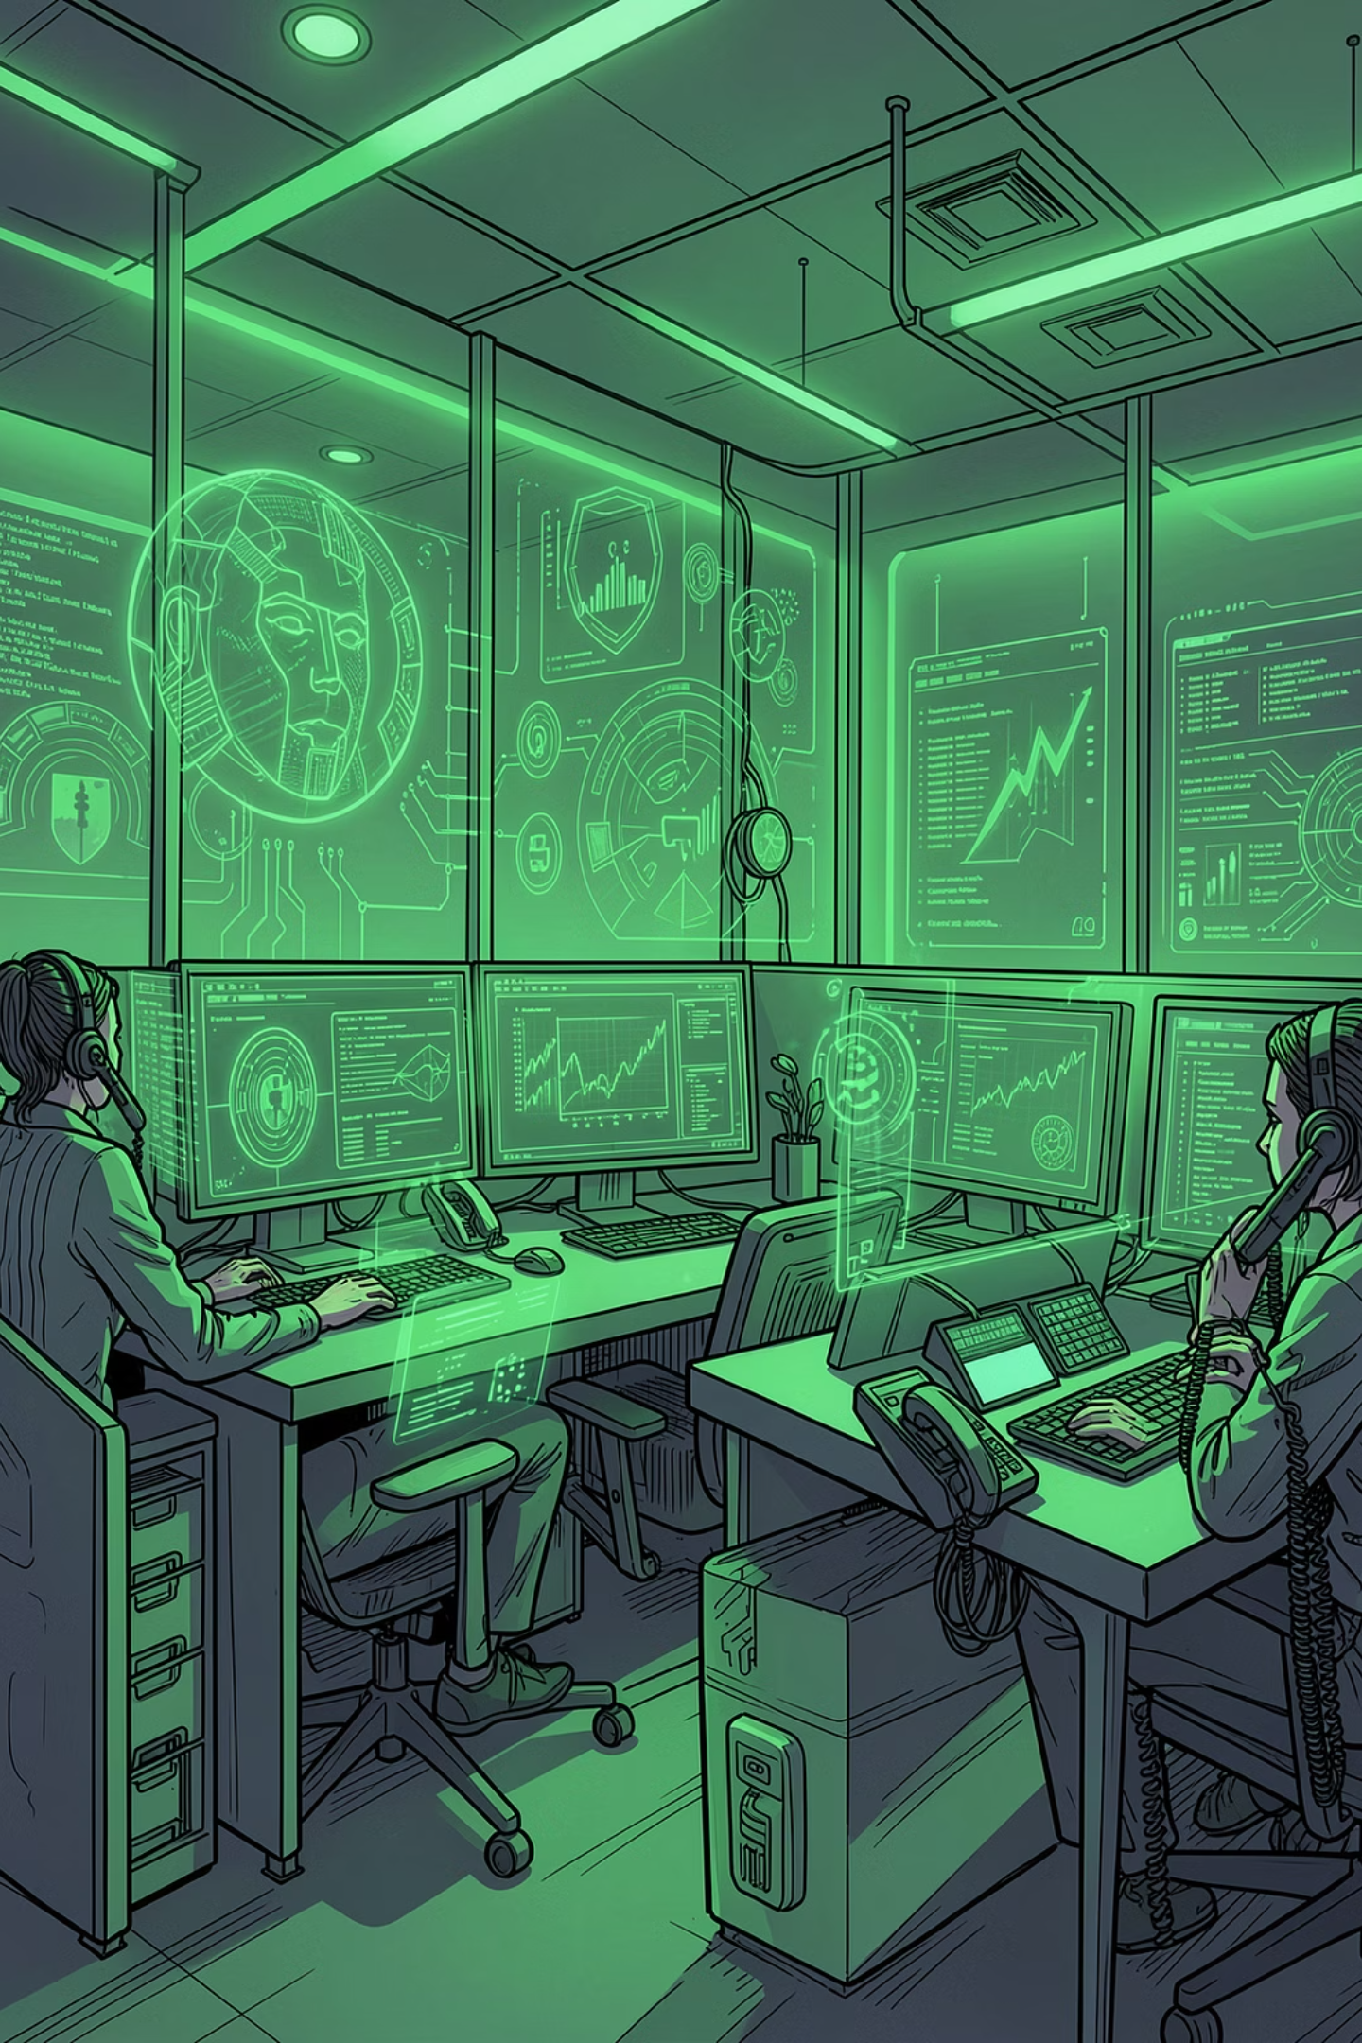
Conclusions & Future Work
Key Contributions
Six-module call-center framework · Hybrid spectral-temporal features · CNN + BiLSTM dual-stream · Adaptive Bayesian fusion · Telecom robustness · Sub-100 ms deployment-ready architecture
Limitations
Conceptual design — not yet empirically validated · ASVspoof datasets may not reflect full call-center diversity · Audio-only (no multimodal biometrics) · Requires continuous updates as deepfake techniques evolve
Future Directions
Full implementation and real call-center deployment · Integrate Wav2Vec 2.0, HuBERT, WavLM · Multilingual and multi-accent testing · Explainable AI (SHAP/LIME) · Adversarial robustness evaluation · Privacy and regulatory compliance

